Slide 1
Neuronal Networks III practical Example

Slide 2
We want to deepen what we have learned so far and do the calculations for a neural network manually.
For this we use a very simple network and at the same time show the application of a non-graphic task.

Slide 3
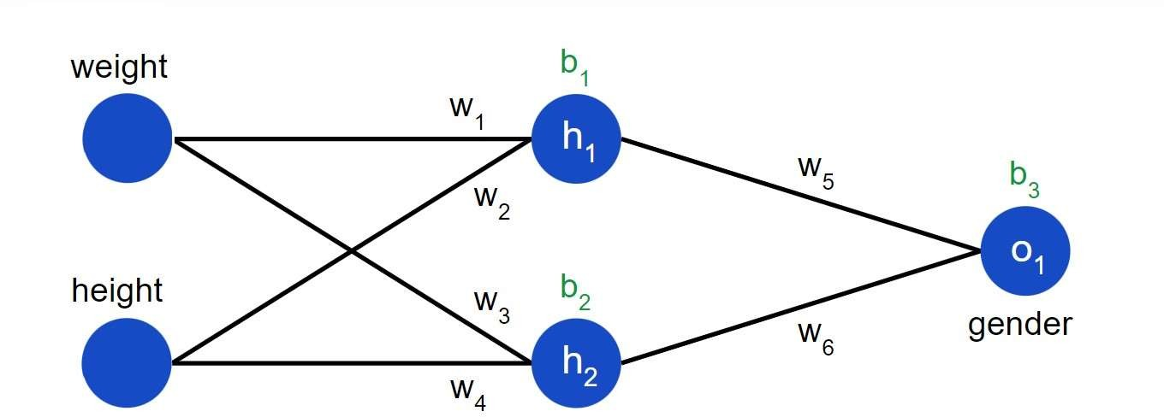
This network consists of only 5 neurons. • 2 input neuron • 2 neurons in a hidden layer • 1 output neuron
The network should read a person's • weight [kg] and • height [cm] into the two input neurons.

Slide 4
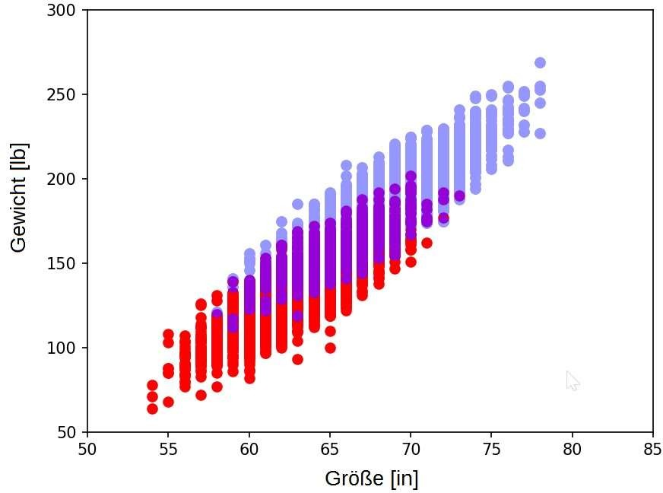
The output neuron should give the likelyhood that the corresponding person is female.
Is that even possible?
Yes, at least partially. The graph above shows the distribution of weight a height from a list of 500 random people.

Slide 5
We do see an overlap area in which no good predictions will be possible, principle, if it is only a question of probabilities, a certain prediction can b The network should indicate in the output layer whether a woman or a m suspected.
• Values close to 1 should indicate a woman
• Values close to 0 man
• Values around 0.5 are intended to show an
indeterminate result

Slide 6
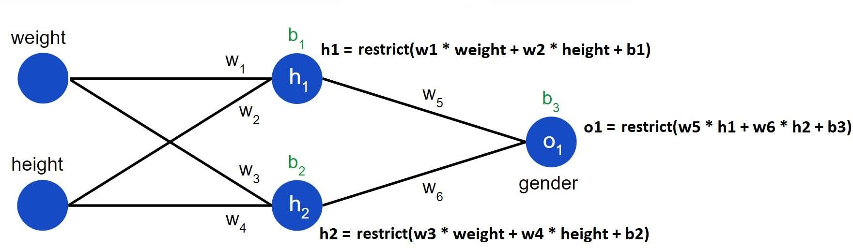
• h1 and h2 are the activations of the 2 inner (hidden) neurons
• o1 is the output value • w1-w6 are the weights
• b1-b3 are the biases
hr, h2 and o1 are calculated as shown above.

Slide 7
We use the "restrict()" function so that the values in the nodes are always in the interval [-1, 1].
Otherwise the activations could increase too much. Values that are already between 0 and 1 are hardly changed or not changed at all, values that are too large or too small are compressed so that they fall within the desired limits.

Slide 8
Advanced content, training of the network: training.pptx
In the simulator (see index.html in the folder simulator) you can try out the response of the network yourself for different inputs.

Slide 9
Links
Machine Learning for Beginners, an Introduction to Neural Networks: https://towardsdatascience.com/machine-learning-forbeginners-an- introduction-to-neural-networksd49f22d238f9
Like above on the author's page:
https://victorzhou.com/blog/intro-to-neu networks/
Source of weight data:
https://www.kaggle.com/
vc
Python program of this network: simple_nn.py
Another version with "leaky ReLU" instead of sigmoid: simple_nn_leaky_relu.py

